Slide 1
3 Axis Pin Dev. Update
Week #13

Slide 2
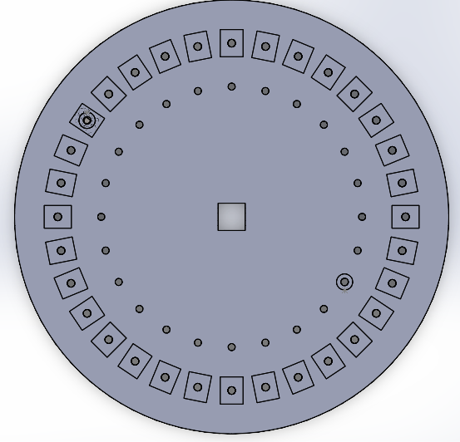
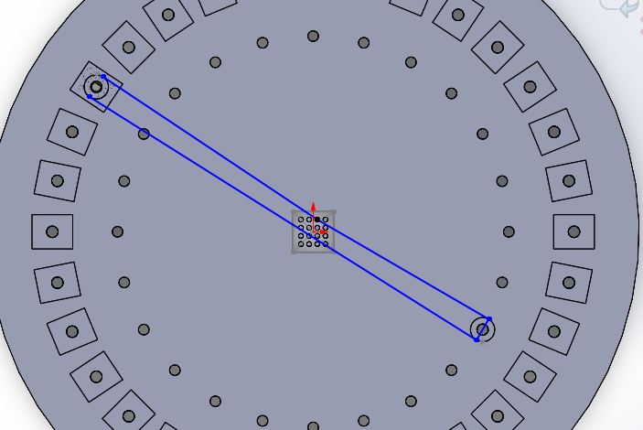
Design
32 Motors (2 for each axis for 16 pins) placed in a circular pattern
32 Inner Pulleys to loop around so that pin can move in both directions along a particular axis

Slide 3
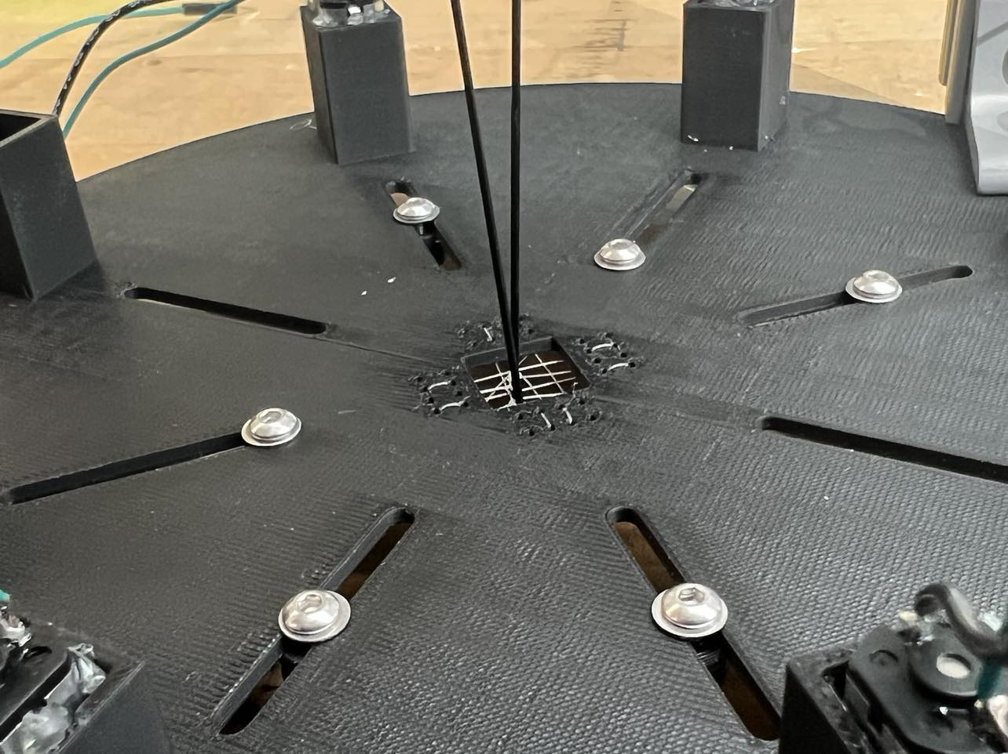
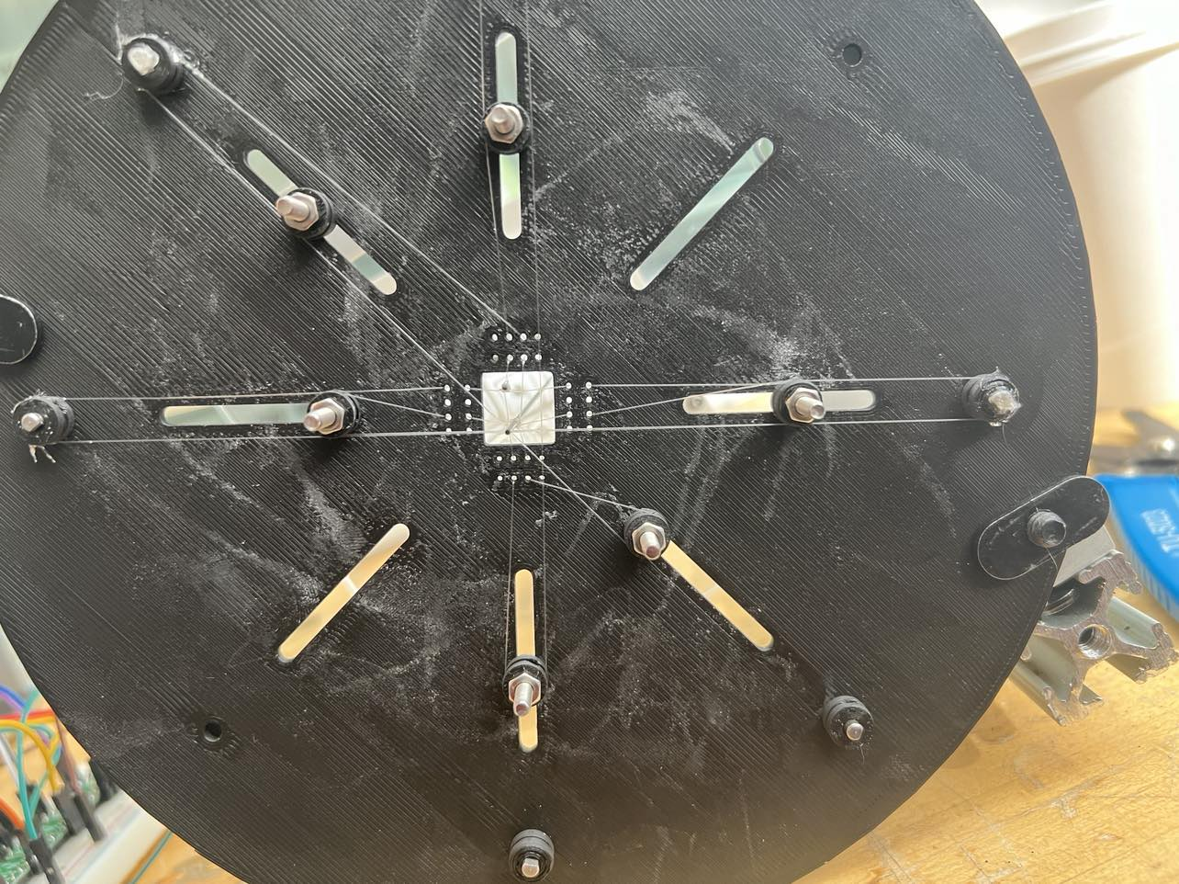
Physical Implementation

Slide 4
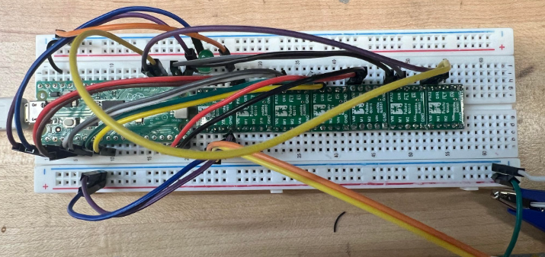
Working Circuit (8 Motor Drivers for 4 Pin Control)

Slide 5
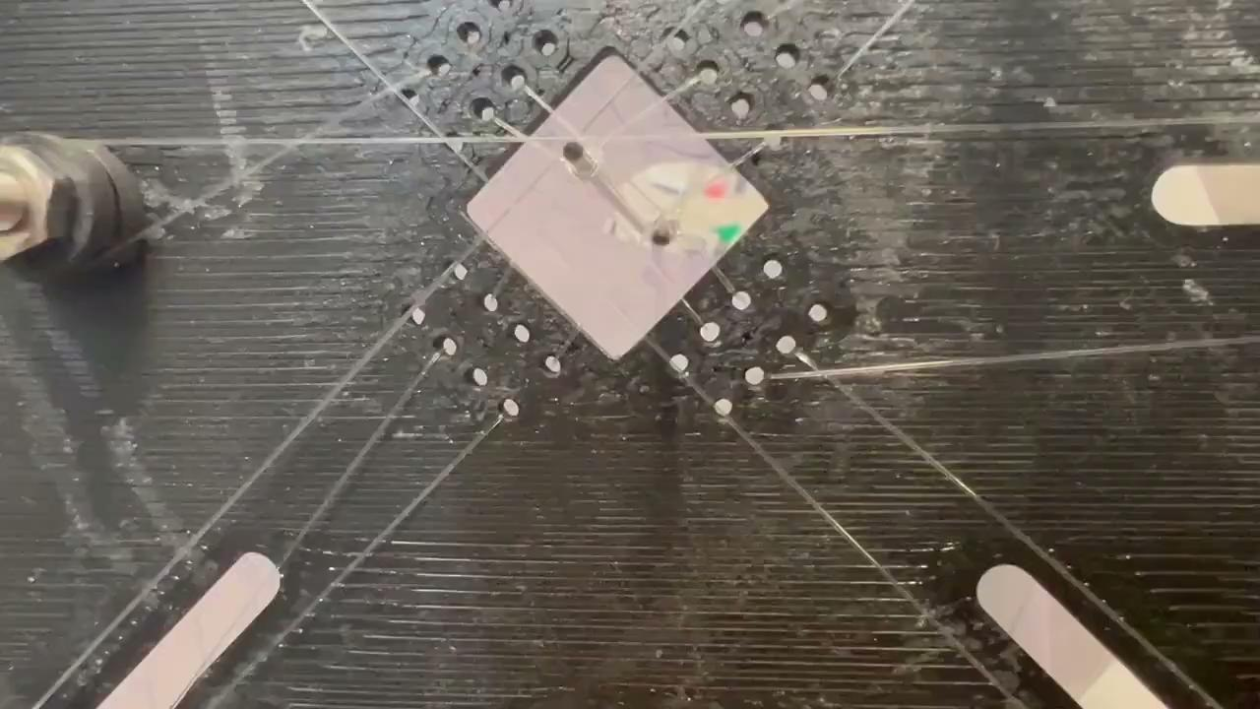
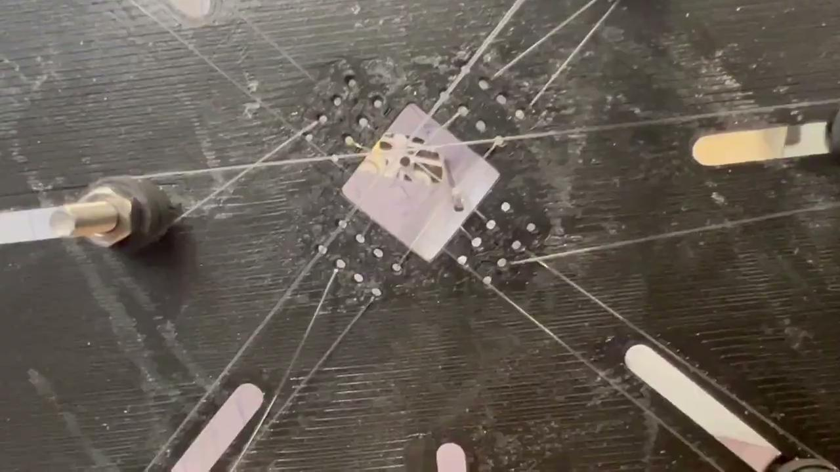
1 Axis Motion

Slide 6
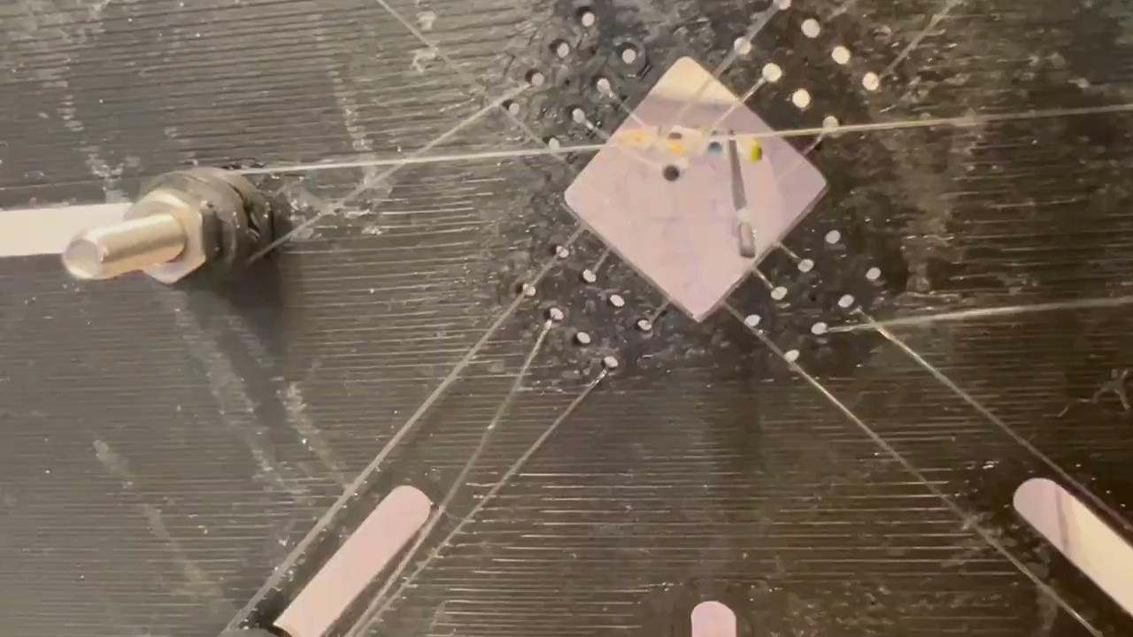
2 Axis (Diagonal) Motion

Slide 7
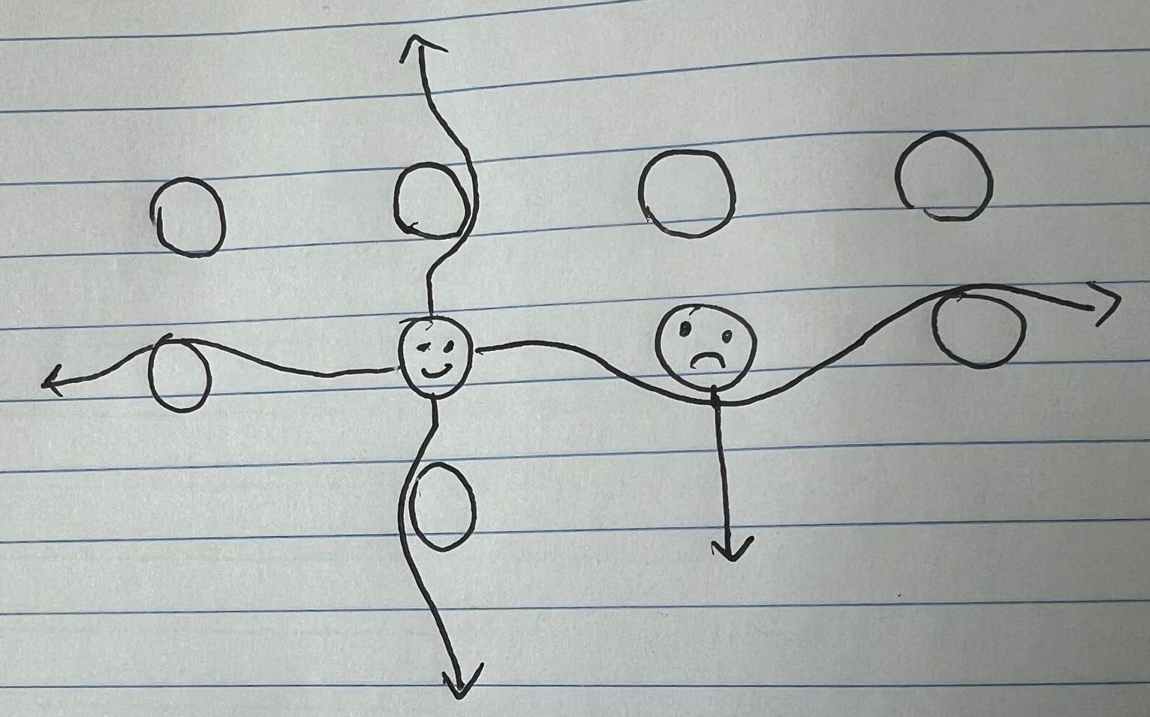
Current Issue:
Not very deterministic
Strings add unwanted friction
If left pin (happy) is able to move in plane, the right pin (unhappy) is restricted in the downward direction due to constraint from string wrapping around
Solution:
Better Design (next slide)
Face problem head on and
Implement controls algorithm to
figure it out for us (ML / feedback control)

Slide 8

New Design (To be prototyped…)
Rigid ‘Frame’ (red) for each of the outer pins that only moves one pin each
12 frames stacked on top of each other to control each of 12 outer pins
Inner pins can similarly be connected to a rigid frame (a bit more challenging)
Each frame is actuated by a similar motor/string/pulley system
Pulley
Motor

